Slide 1
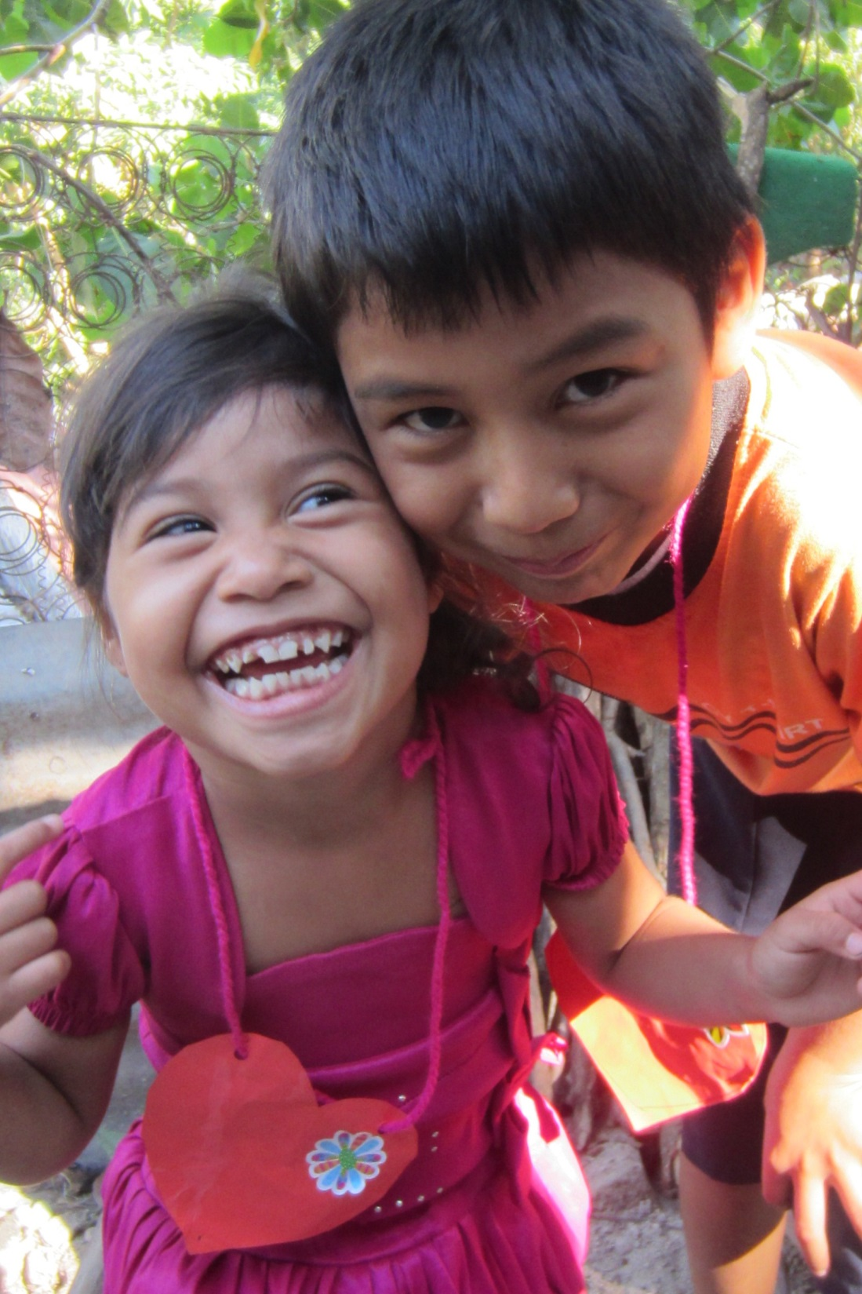
Our Brothers and Sisters in El Salvador

Slide 2
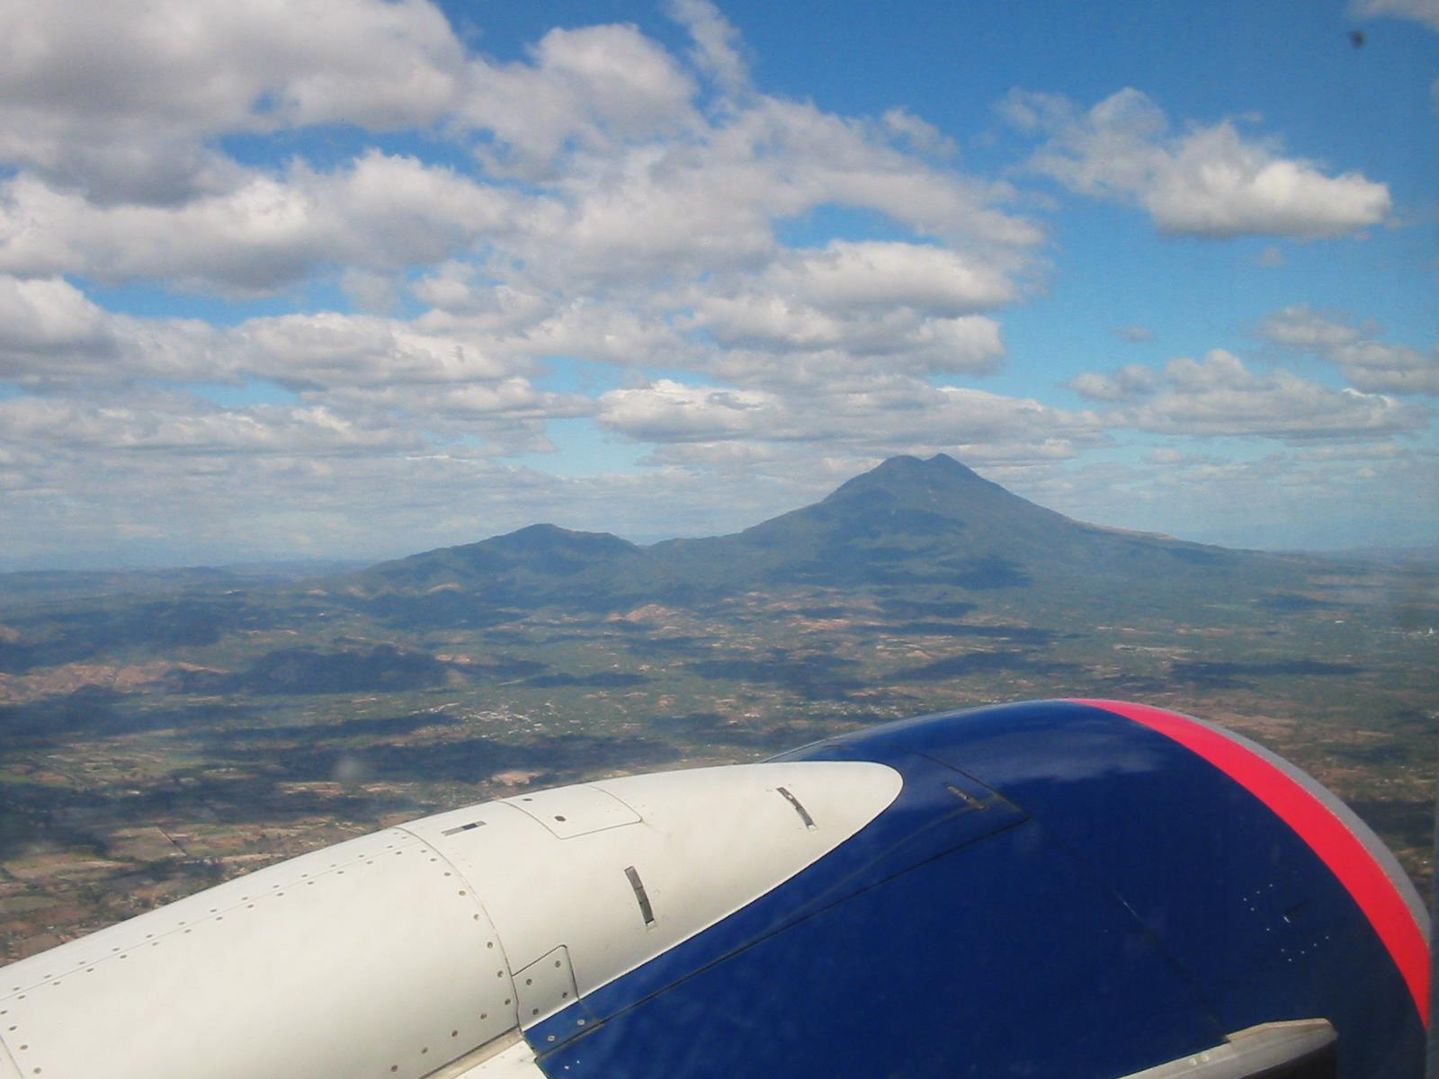
Today…

Slide 3
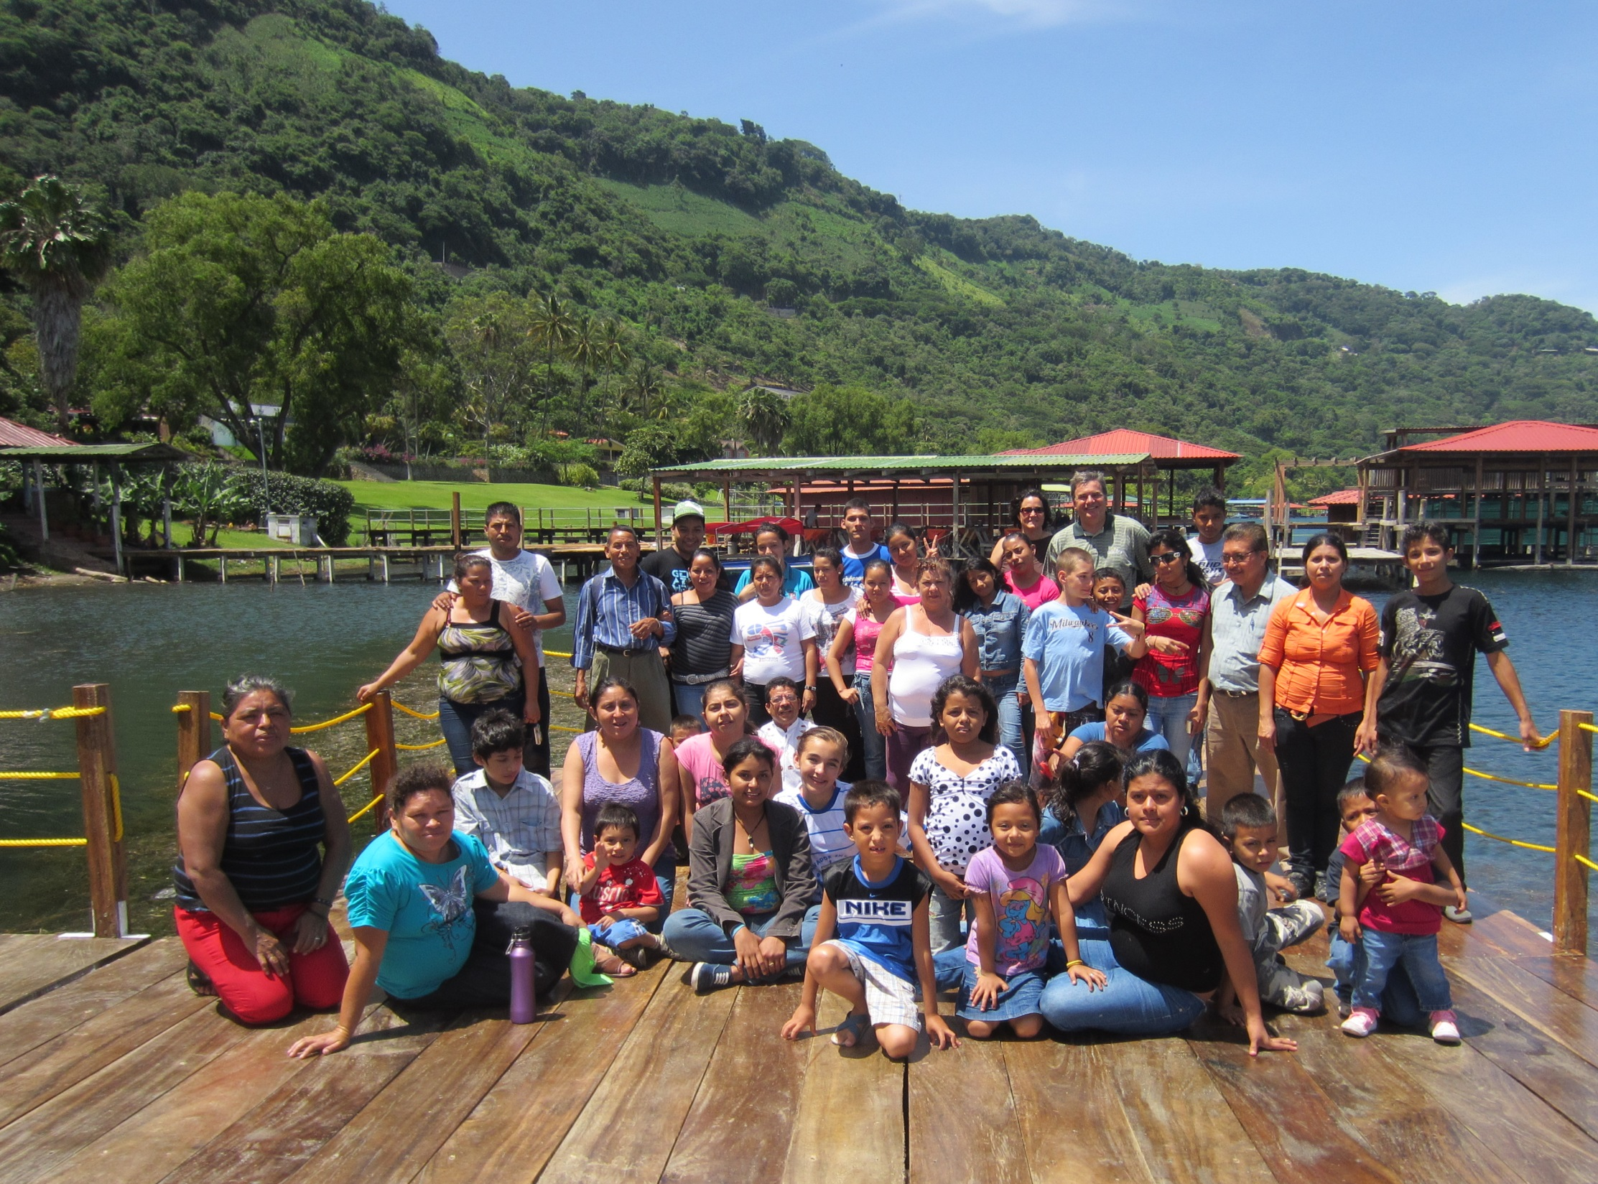

Slide 4
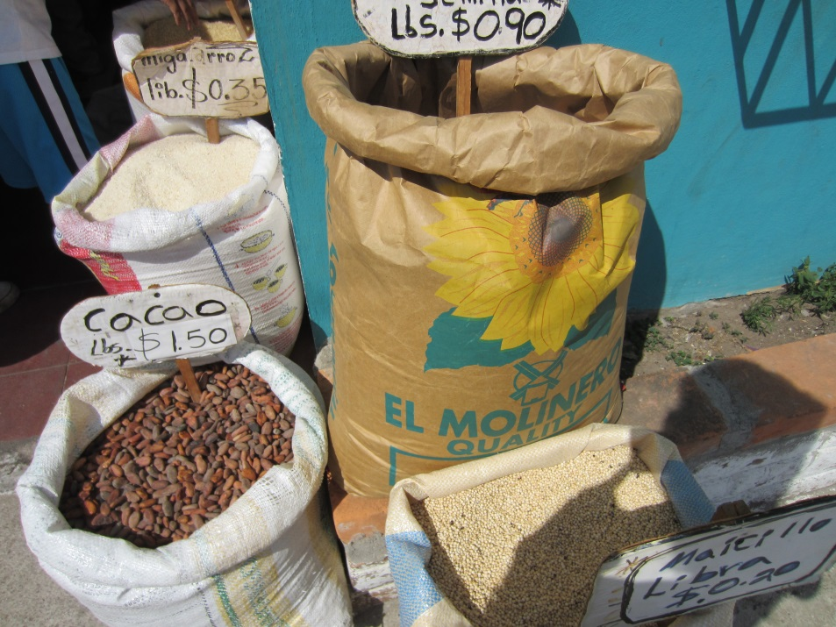
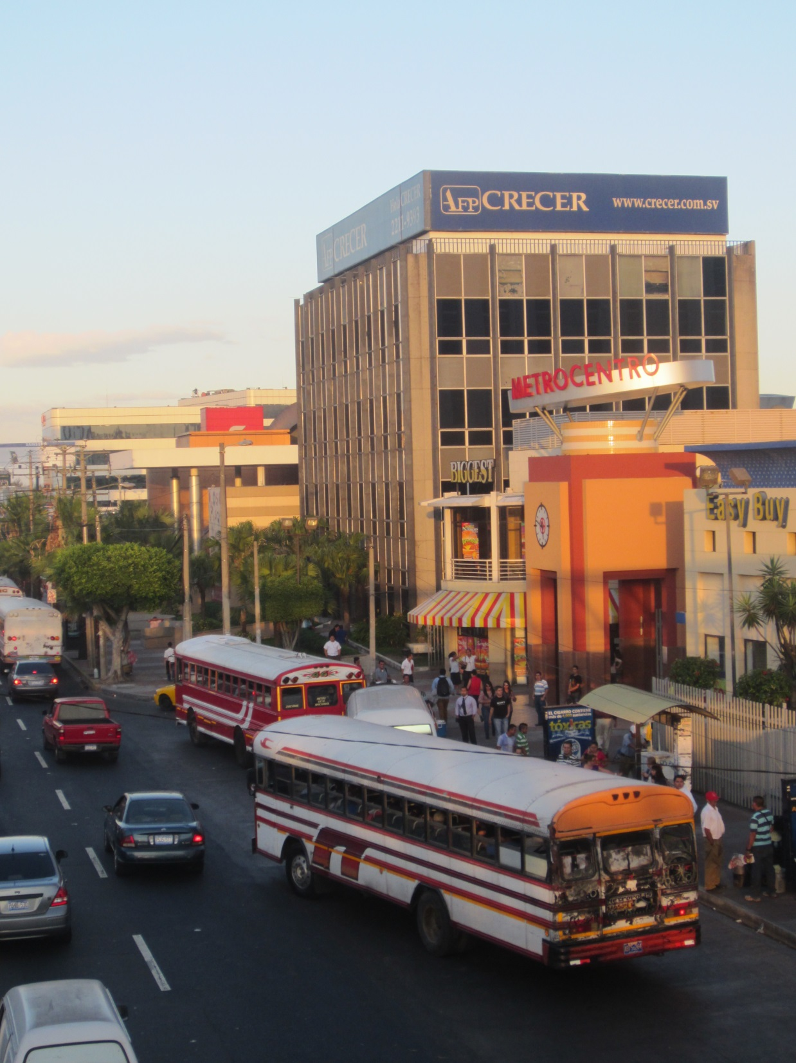
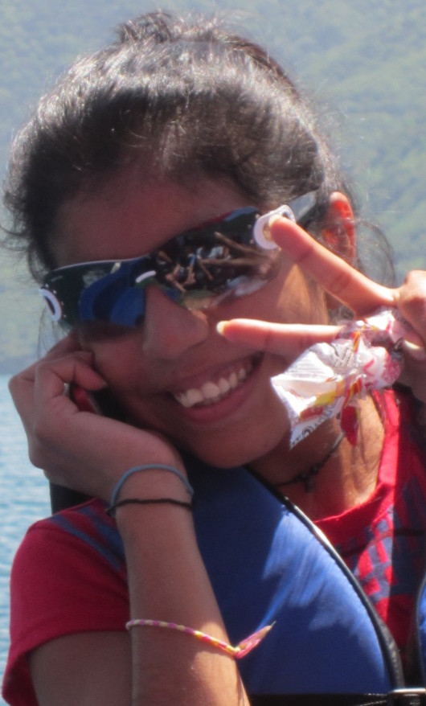
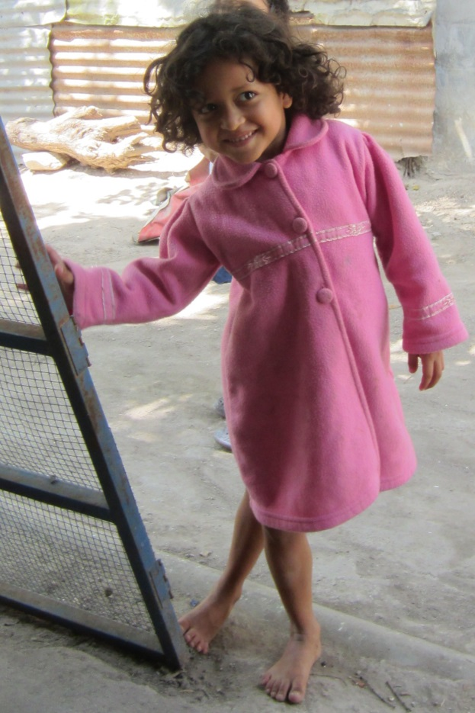
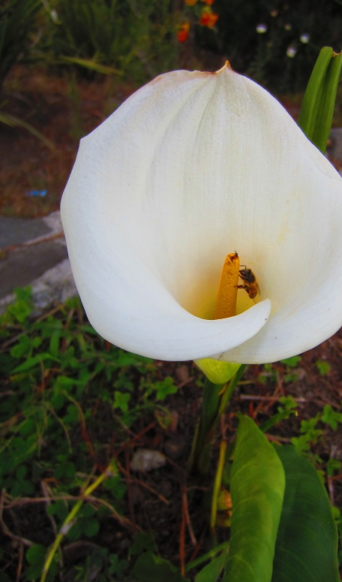

Slide 5
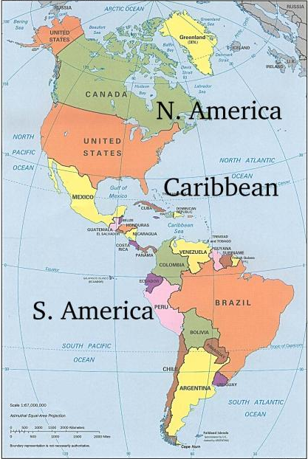
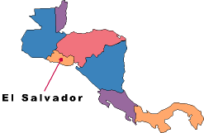
El Salvador
A look back…

Slide 6
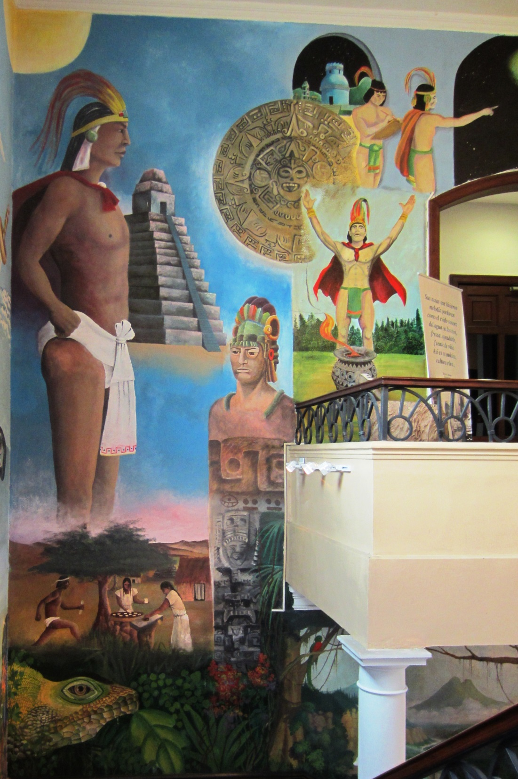
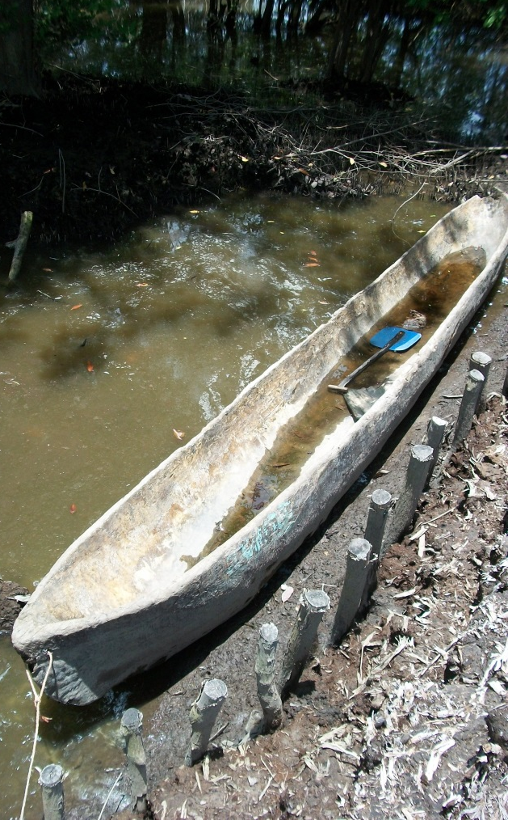

Slide 7
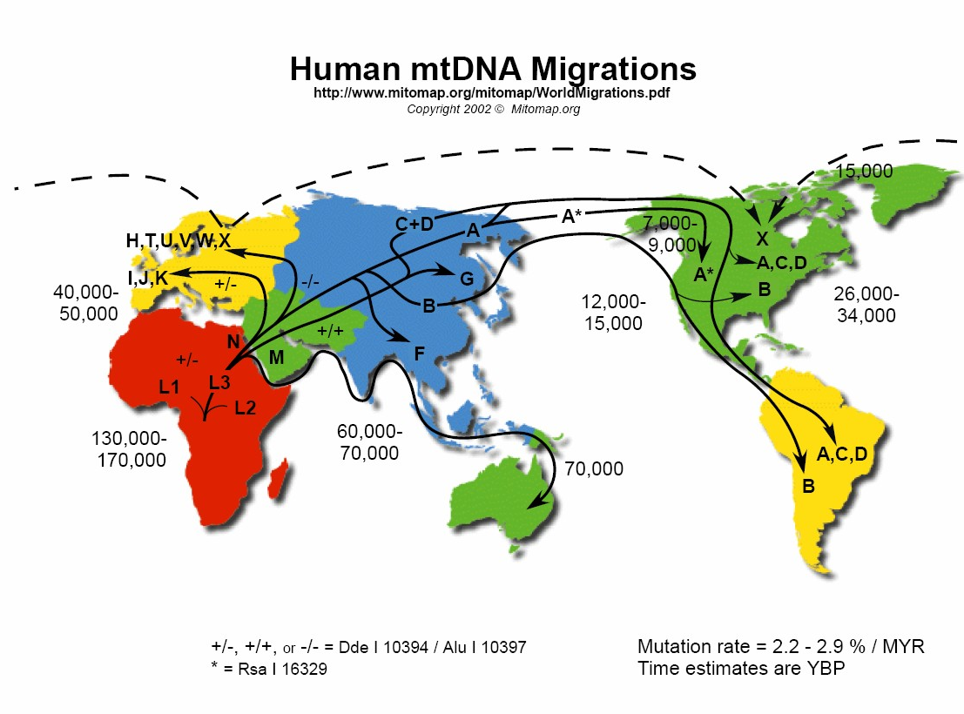
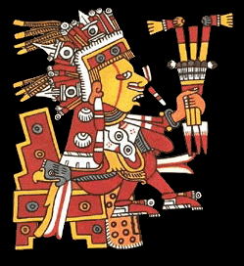
The Indigenous Peoples

Slide 8
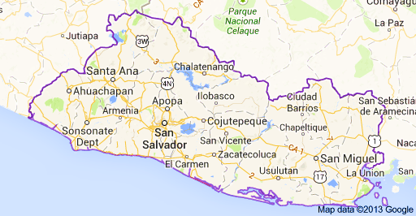
Before the Spanish conquest, the area now known as El Salvador consisted of three indigenous states and several principalities. The western part of the country was governed by the Pipils, a Nahua nomadic people from central Mexico. North of the Lempa River, the Chortis Maya ruled. Their culture was similar to the Aztec and Mayan peoples. The east was governed by the Lencas.

Slide 9
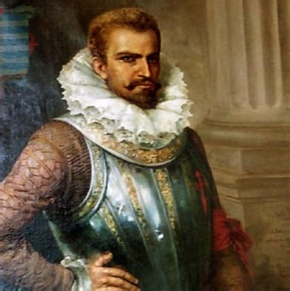
The Spanish Conquest
In 1524, Pedro de Alvarado was the first to attempt exert Spanish control over what is now El Salvador. He was repelled by Pipil warriors, but was eventually successful in 1525. He conquered the Pipil capital, Cuscatlán and renamed the district “El Salvador” (“The Savior”). It was under the Audiencia of Mexico, then Panama and then Guatemala (all under Spain).

Slide 10
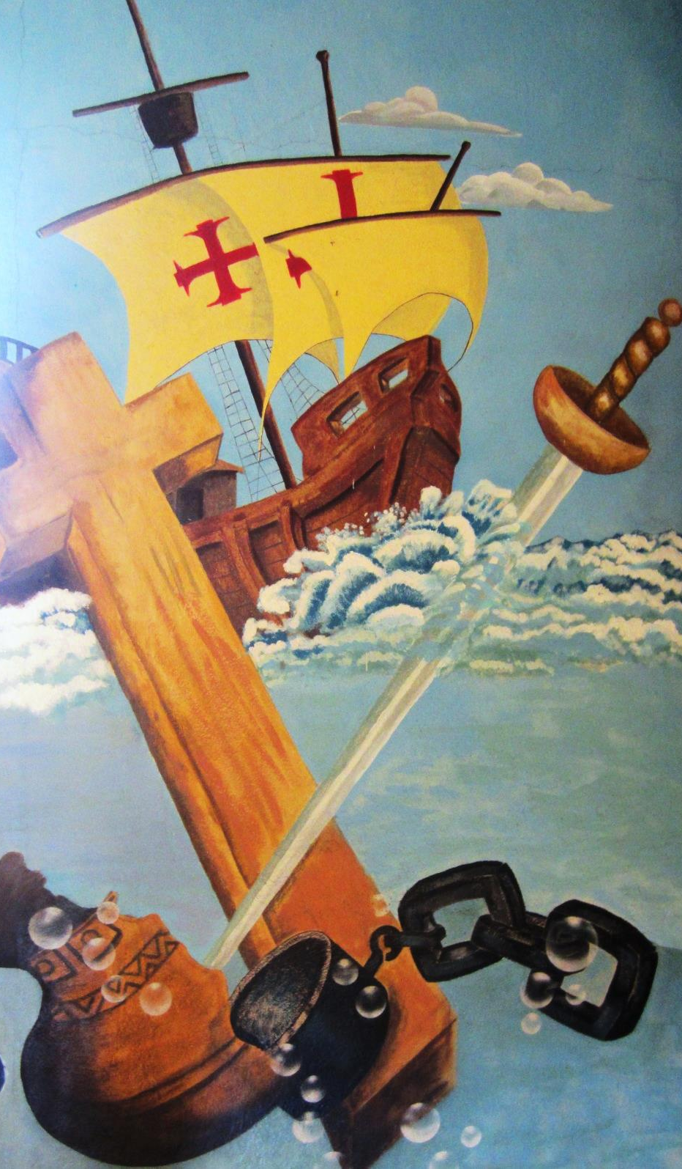
The Land
During the next 300 years, wealthy landowners enslaved the indigenous people, and acted as feudal lords.
The gap between the wealthy (known as the 14 families) and the poor (indigenous, mixed race and everyone else) was supported by the government.
The landowners grew cash crops, deforesting the land and causing permanent change in the environment and climate.

Slide 11
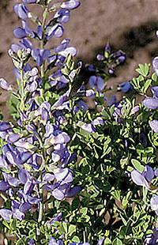
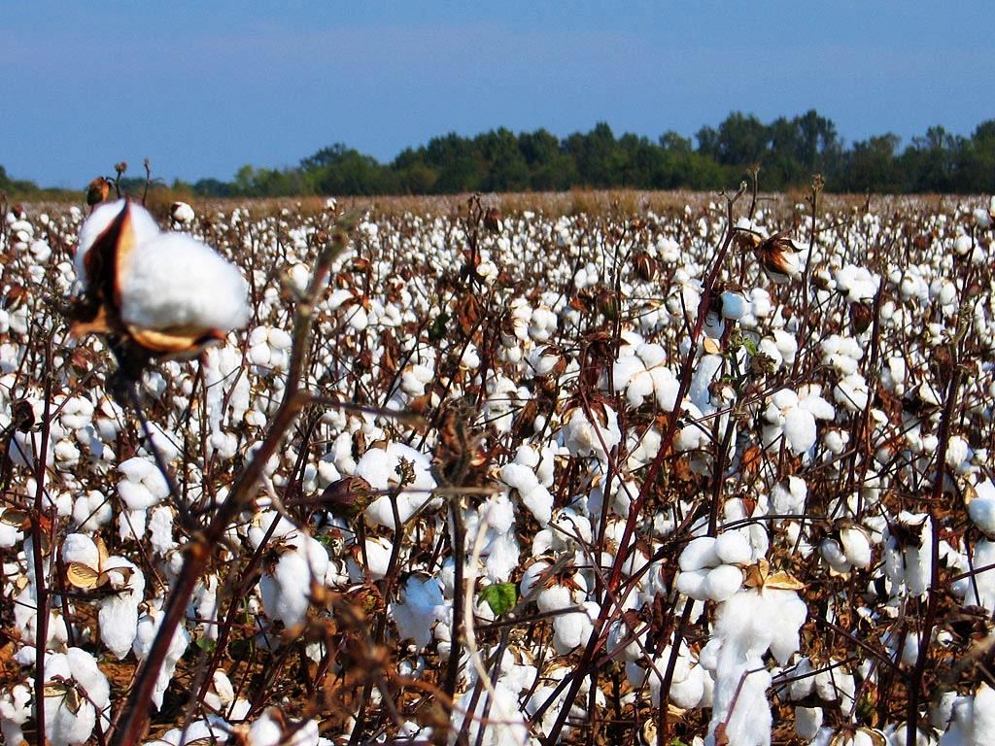
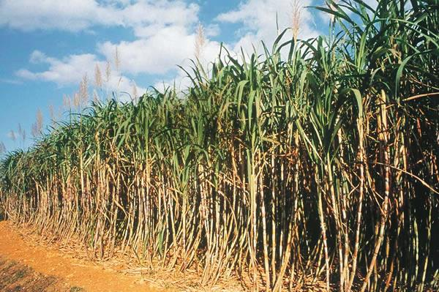

Slide 12
The Central American Federation declared independence from Spain in 1821. In 1822 El Salvador, fearing incorporation into Mexico, petitioned the United States government for statehood.
In 1832, Anastasio Aquino led an indigenous revolt against Criollos and Mestizos near San Vicente. The source of the discontent of the indigenous people was the lack of land to cultivate. The problem of land distribution has been the source of many political conflicts in Salvadoran history.
The Central American federation was dissolved in 1838 and El Salvador became an independent republic.

Slide 13
Oligarchy & Military Rule
The wealthy families controlled election processes and altered the constitution to their benefit.
In 1931, the military overthrew the president and began an era of rule by military dictatorship, with occasional elections (neither free nor fair).

Slide 14
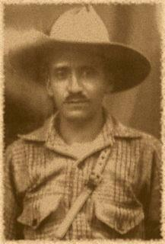
La Matanza
La Matanza means The Massacre
In 1932, there was a revolt by peasants and indigenous people and led by Farabundo Martí
Farabundo Martí was highly educated, left his career to advocate for the poor, and helped to found the Communist Party of Central America
The Salvadoran military quickly squashed the rebellion and murdered anyone who appeared to be indigenous, killing more than 30,000 native peoples and peasants

Slide 15
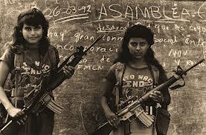
By the early 1970s, several small guerilla groups had formed, believing change would only come through armed struggle.

Slide 16
El Salvador still had a near feudal land system. Only 2% of the country's population controlled 60% of the farmable land. The majority of the people suffered from extreme poverty, high unemployment and overpopulation.
As the poor organized, the wealthy sent their military and death squads to repress anyone who was suspected of being organized and demanding their rights.

Slide 17
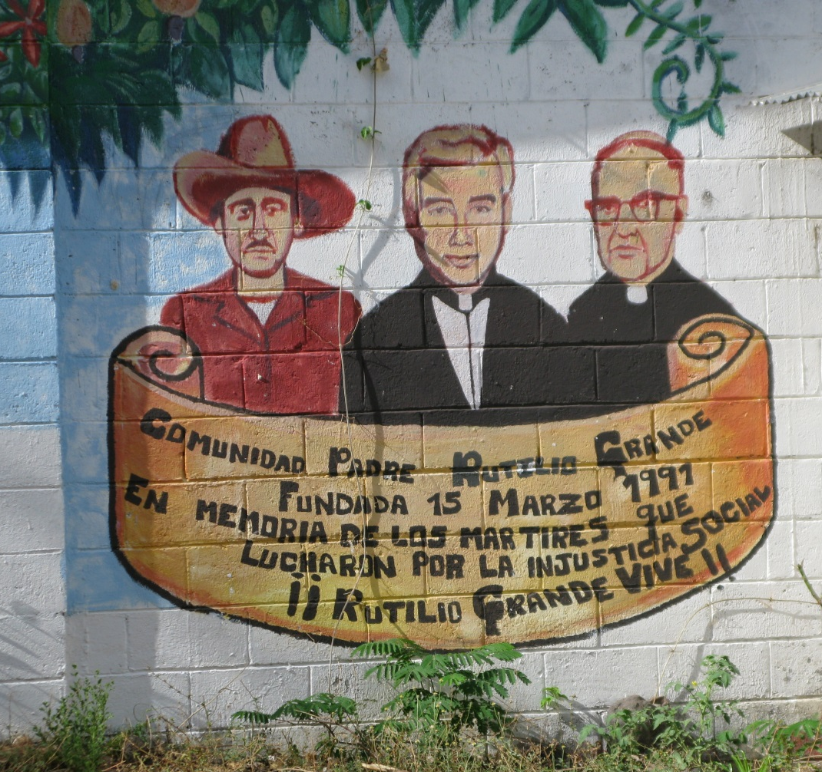
Parts of the Catholic church sided with the poor. The wealthy were not pleased with this new consciousness and accused the Church of becoming "politicized."
On March 12, 1977, Father Rutilio Grande was murdered by a death squad while traveling to El Paisnal.

Slide 18
The death of his friend, Rutilio, had a great impact on Monseñor Oscar Romero. He began to speak out against the atrocities of the government.

Slide 20
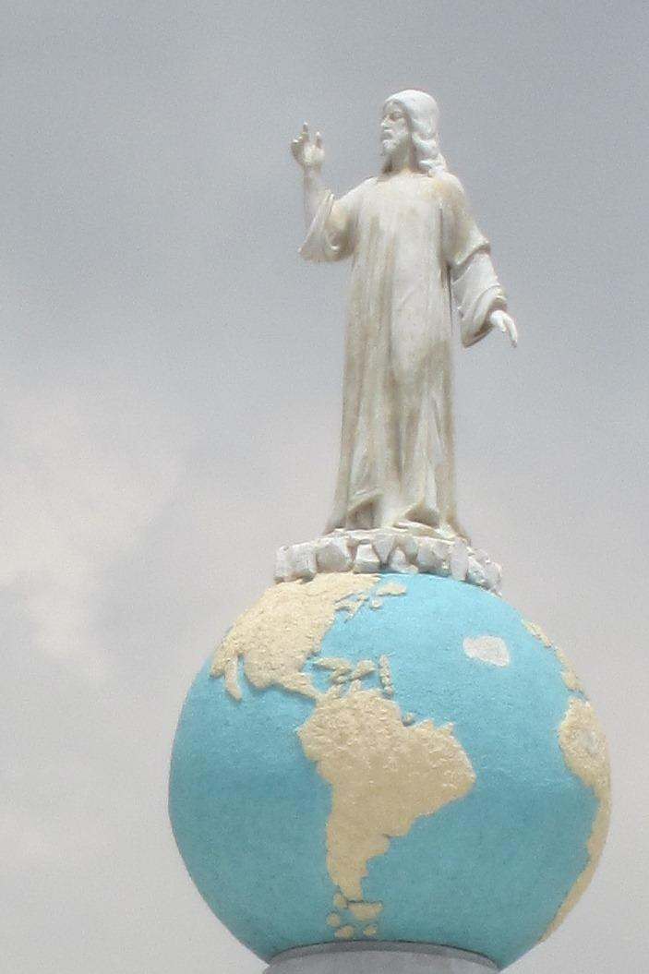
"A Church that does not unite with the poor to denounce, poverty, the injustices committed against them, is not the true Church of Jesus Christ."

Slide 21
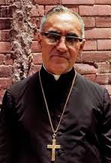
On March 24, 1980, Archbishop Romero was assassinated while saying mass in San Salvador. The Sunday before he had called on soldiers to disobey orders received to kill innocent civilians.
…That year the civil war began.

Slide 22
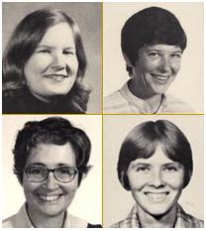
Later that same year four U.S. churchwomen in El Salvador are abducted and killed.
Dorothy Kazel, Ita Ford
Maura Clarke, Jean Donovan

Slide 23
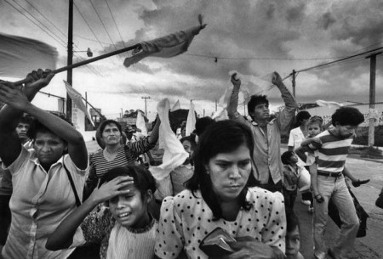
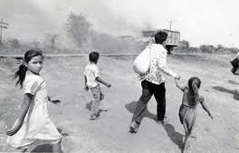
Over the course of the decade, some 70,000 civilians died at the hands of the Salvadoran security forces and their associated death squads.
The Salvadoran government forces were supported by US military aid, advisers, and training.

Slide 24
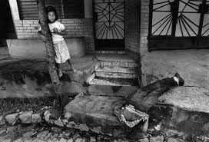
Civilian Atrocities
“…soldiers would invade, and they would kill every living thing - animals and people - everything. We'd flee into the mountains…there were women and they would say, "What would I do out there with my children? I'm staying here." And then they were lined up and machine-gunned to death…”
Margarita Acosta de Alas,
Civilian

Slide 25
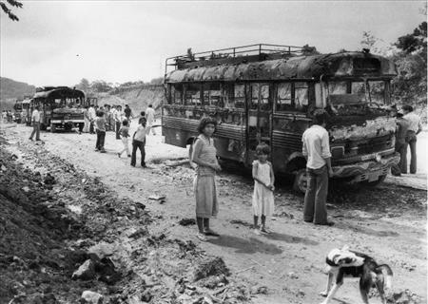
Over 1,000,000 people fled the country.

Slide 26
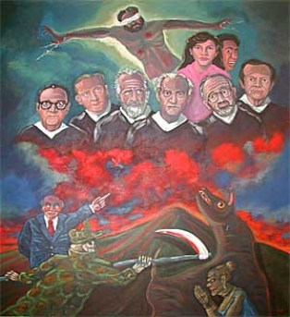
On November 16 1989, senior army officers ordered soldiers to kill six outspoken Jesuit priests at the University of Central America. They were dragged out of their bedrooms and murdered, along with their housekeeper and her daughter.

Slide 27
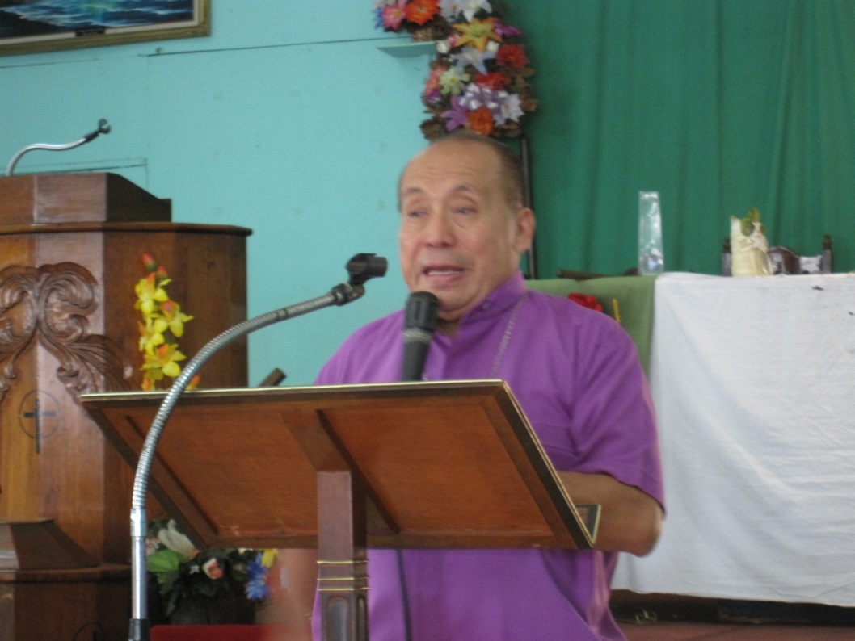
A short time later, the death squad went to Resurrection Lutheran Church to assassinate Bishop Medardo Gómez. He had received warning and escaped 15 minutes prior to their arrival.
The soldiers arrested others who were at the church, including Canadian missionary, Pastor David Ruhle.

Slide 28
The Salvadoran Lutheran Church
Jesus is found wherever there is a believer: in the street, in the home, the factory, workshops, schools, offices, refugee camps, hospitals, jails, garrisons, battle zones, in the mountains, and in the city. God is present with the true disciple, struggling against oppression, misery, captivity and death.
Medardo Gomez, Fuego contra Fuego (Fire Against Fire), 1990 Augsburg Fortress

Slide 29
Salvadoran Lutheran Church: During the war
In the spirit of Archbishop Romero, Bishop Gómez spoke out on behalf of the poor and dispossessed
Bishop Gómez was abducted and tortured - let free only after international pressure
Pastor David Fernandez was killed by death squads
Many Salvadoran Lutheran Church pastors were targeted with death threats. Several were arrested and tortured. International companions, including people from the Greater Milwaukee Synod, provided support and protection
In 1992, Bishop Gómez was nominated for the Nobel Peace Prize

Slide 30
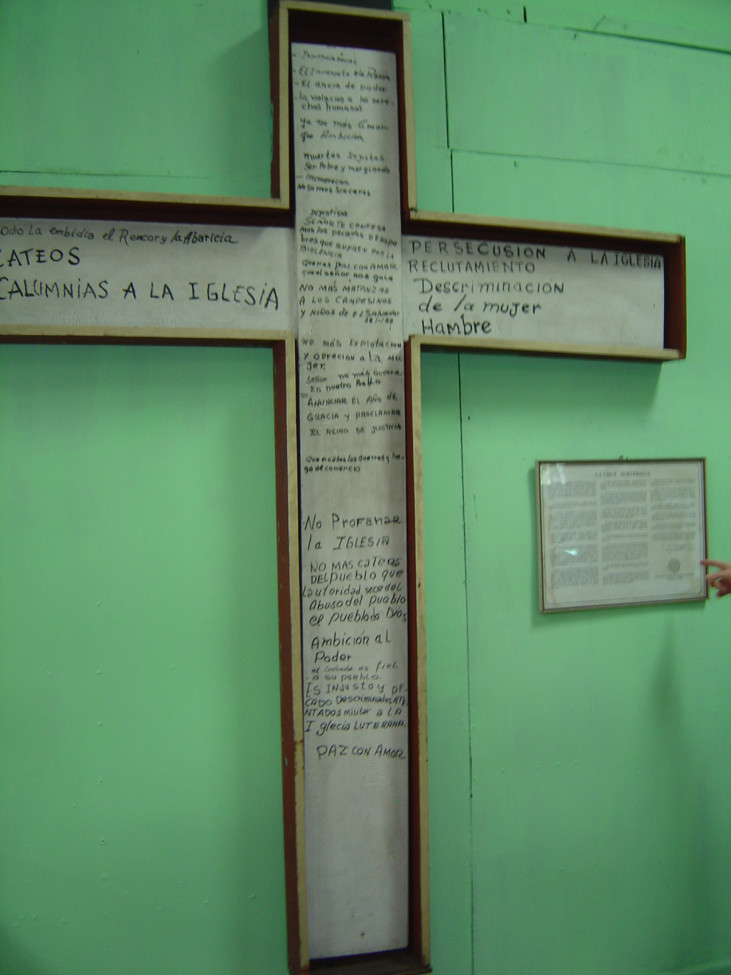
The Subversive Cross

Slide 31
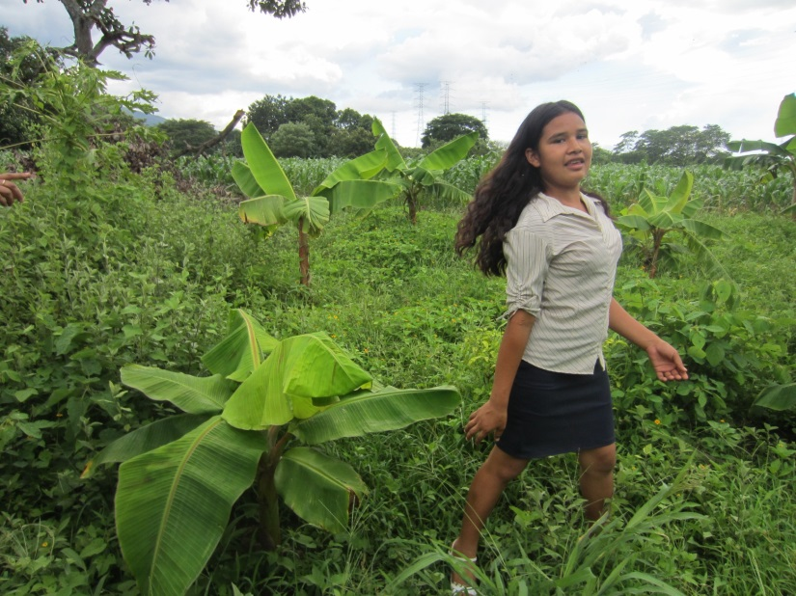
The Salvadoran Lutheran Church operated a refugee camp for internally displaced persons. The camp, Fe y Esperanza, was home to hundreds of families. After the war, the church helped to relocate families.
Today, a congregation continues to gather there and the land is being used for organic agriculture. The buildings are being refurbished and are used for a variety of ministries and educational events.

Slide 32
Unceasing violence prompted both the government and the rebels to begin peace negotiations, under United Nations guidance. The Peace Accords were signed in 1992. Warring parties worked to transform themselves into political parties.

Slide 33
Effects of Civil War
The 12-year civil war claimed the lives of 75,000 people.
600,000 were displaced inside the country
More than a million had gone into exile.
The Salvadoran armed forces, de facto rulers of the country since 1932, were removed from the political process.
A new civilian police force was created
The former military government became the ARENA party, which tends to represent the interests of wealth and business.
The former guerillas formed the FMLN party, which tends to represent those who live in poverty and work the land.

Slide 34
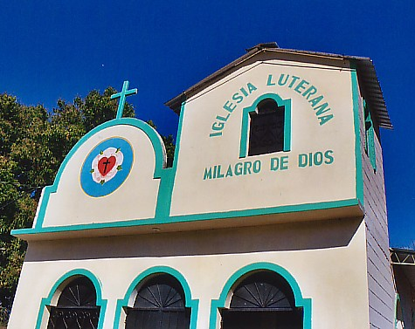
After the War
The Salvadoran Lutheran Church continued to walk with the poor
Speaking out on human rights and environmental issues
Running a health clinic, a homeless shelter and schools
Placing congregations in the most marginalized areas
Resettling refugees

Slide 35
What does a look back teach us about El Salvador Today?
Poverty and Unemployment
Land Issues
Gang Violence
Struggle with Globalization
Emigration

Slide 36
“These people [of El Salvador] shake us up because they bring home to us that things are much worse in the world than we dared to imagine…if we allow them to share their suffering with us, they communicate some of their hope to us as well…and we recognize that there is something going on in the world that is more wonderful than we dared to imagine.” Dean Brackley S.J.

